Slide 1
Classification of Singapore Road
Traffic Signs
with Neural Network
Lek Tiek Leong
22/10/2022

Slide 2
Contents
Problem Statement
Datasets
Exploratory Data Analysis
Preprocessing
Models Building and Evaluation
Results Analysis
Conclusion and Recommendations
Q & A

Slide 3
Overview
Traffic sign classification is the process of automatically recognizing traffic signs along the road, such as speed limit signs, give-way signs, merge signs, etc. Being able to automatically recognize traffic signs enables us to build “smarter cars”.

Slide 4
Problem Statement
This project is focused on the development of a multi-class, single-image classification model using Neural Network to recognise road traffic signs in Singapore.

Slide 5
Datasets
Training dataset
32 classes
2893 images
Test dataset
32 classes
352 images
Training dataset
Validation dataset
32 classes
1954 images
32 classes
939 images

Slide 6
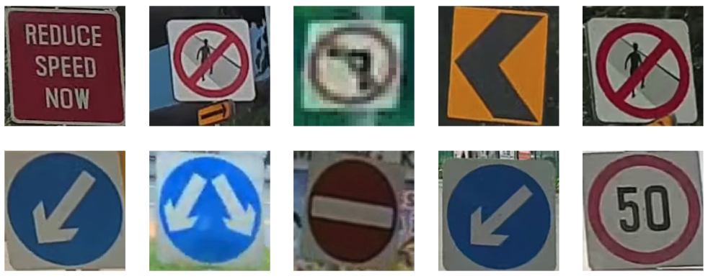
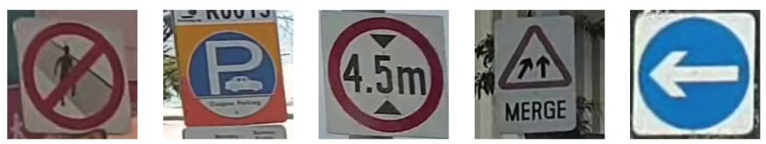

Slide 7
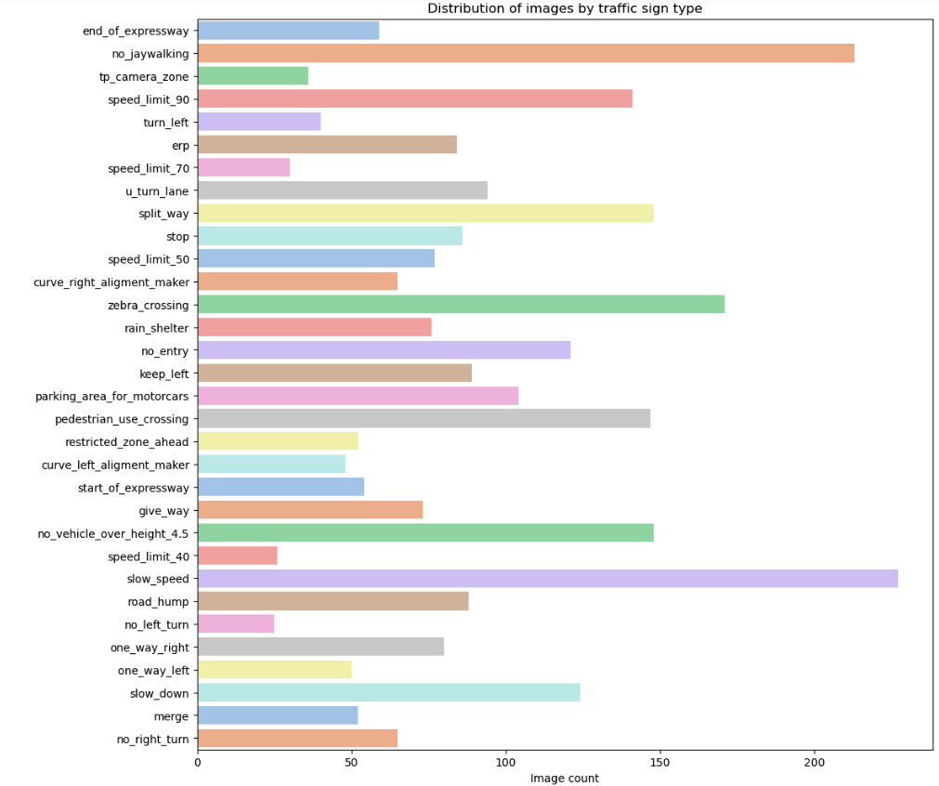
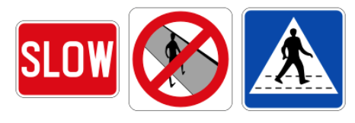
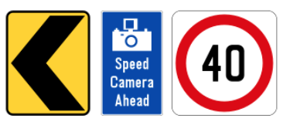


Exploratory Data Analysis
Classes > 150 images
Classes < 50 images

Slide 8
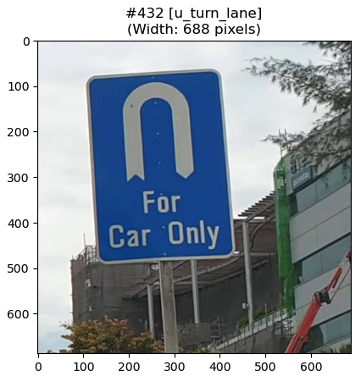
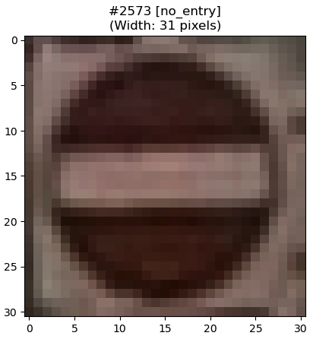
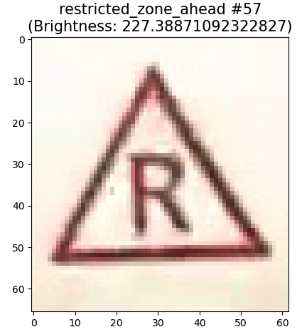
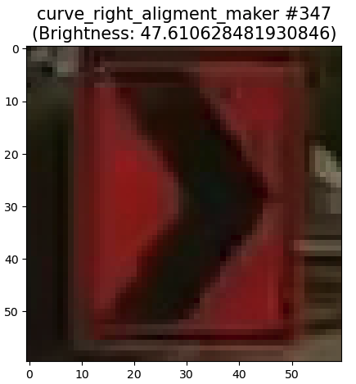
Image with largest width
Image with smallest width
Brightest image
Daekest image

Slide 9
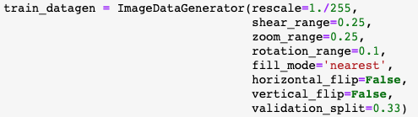
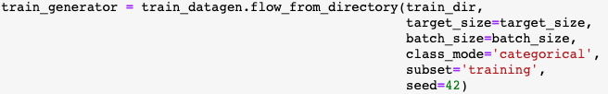
Preprocessing
Keras ImageDataGenerator class
provides a quick and easy way to augment the images.
provide real-time data augmentation.
ensures that the model receives new variations of the images at each epoch.
it requires lower memory usage.

Slide 10
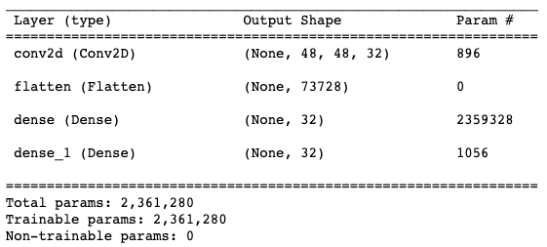
Models Building and Evaluation
CNN Model 1

Slide 11
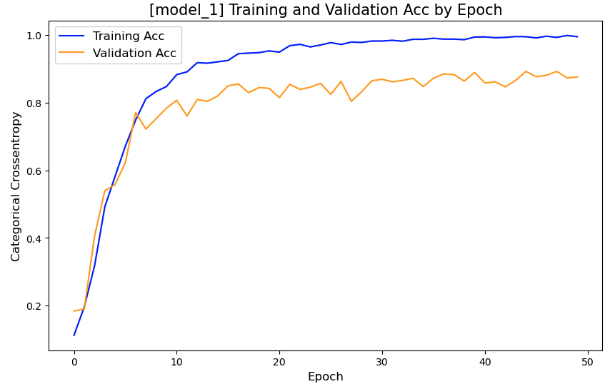
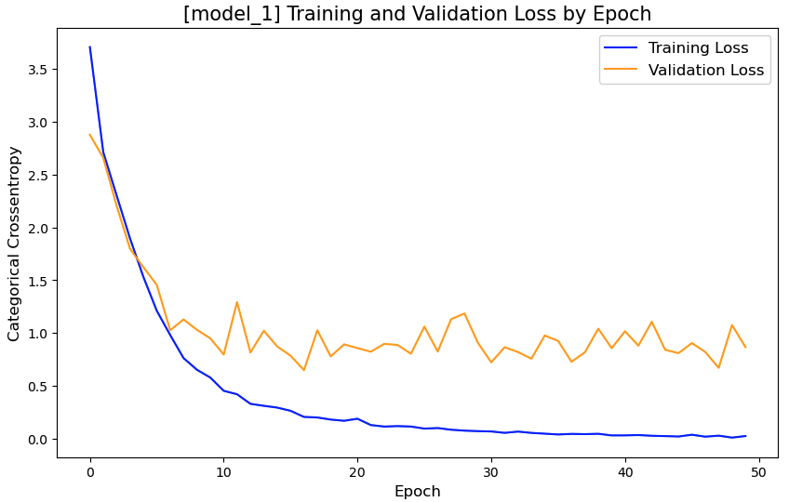
Training accuracy: 99.4%
Validation accuracy: 87.9%
Test accuracy: 60.8%

Slide 12
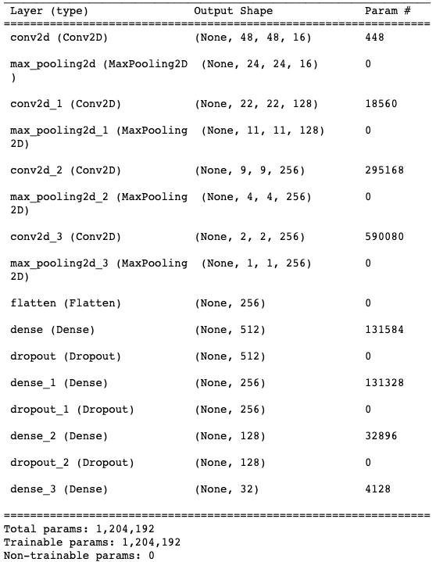
CNN Model 2

Slide 13
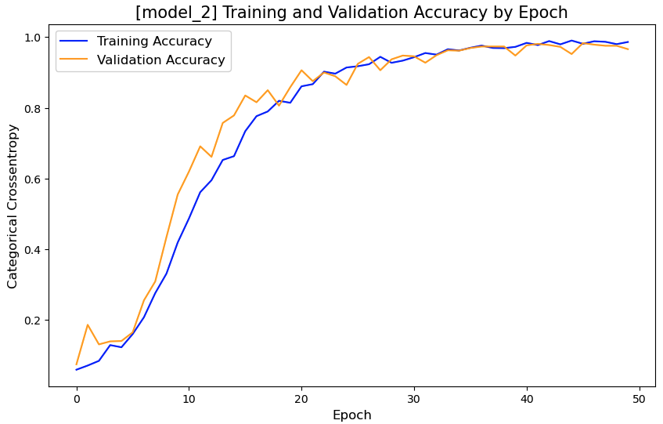
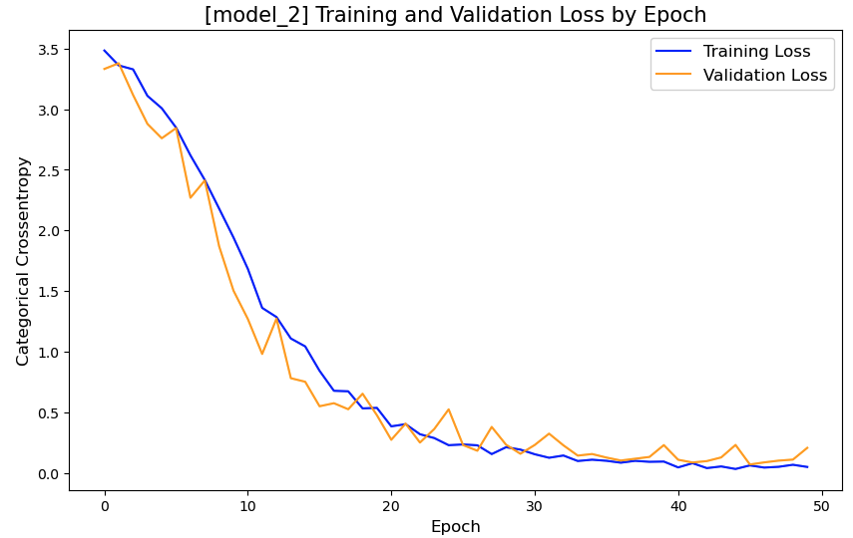
Train accuracy: 99.6%
Validation accuracy: 96.3%
Test accuracy: 90.1%

Slide 14
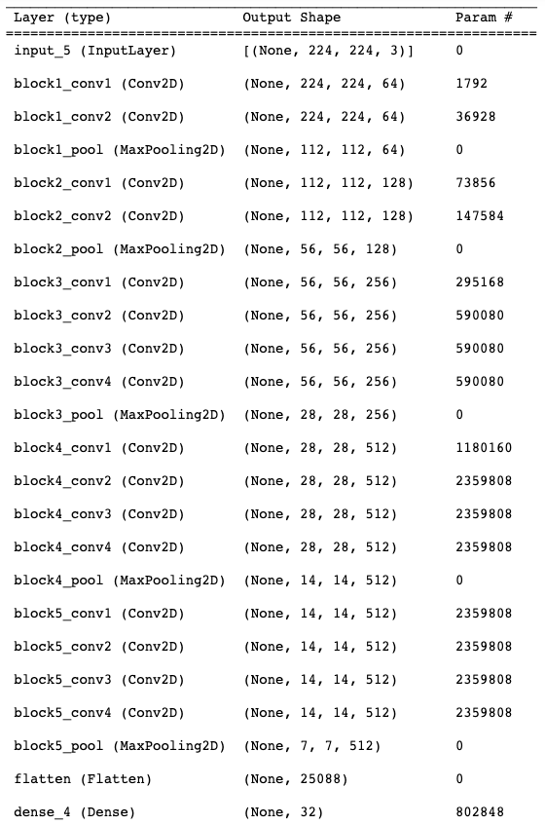

VGG19

Slide 15
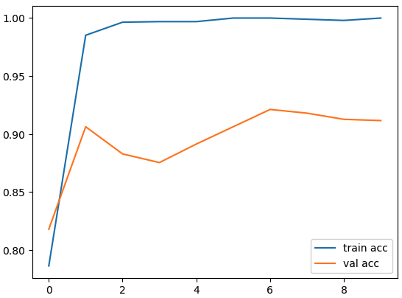
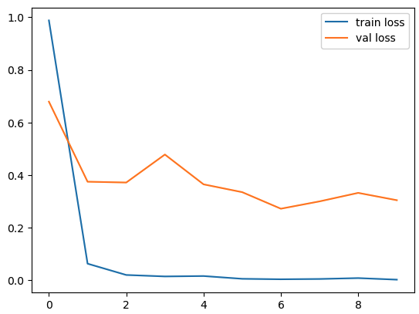
Train accuracy: 100.0%
Validation accuracy: 90.4%
Test accuracy: 87.8%

Slide 16
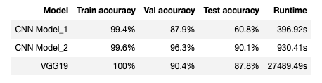
Results Analysis
Final model: CNN Model 2
Reasons:
Highest validation accuracy of 96.3% and test accuracy of 90.1%
Faster runtime

Slide 17
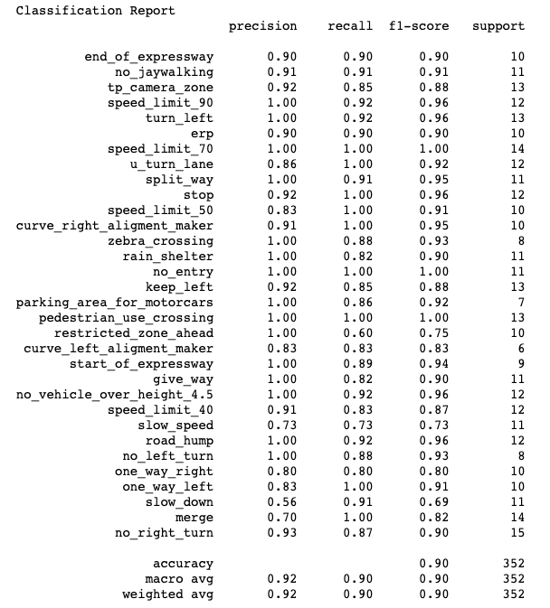
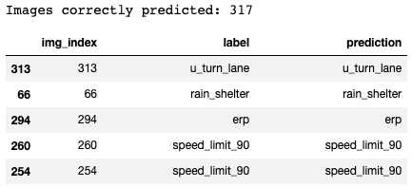
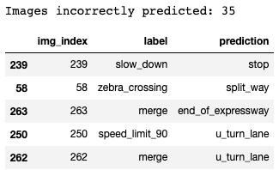

Slide 18
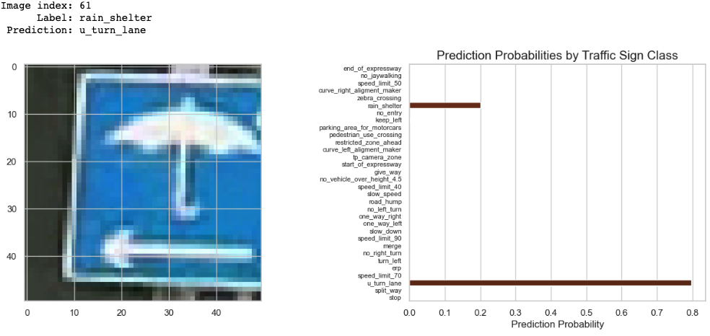

Slide 19
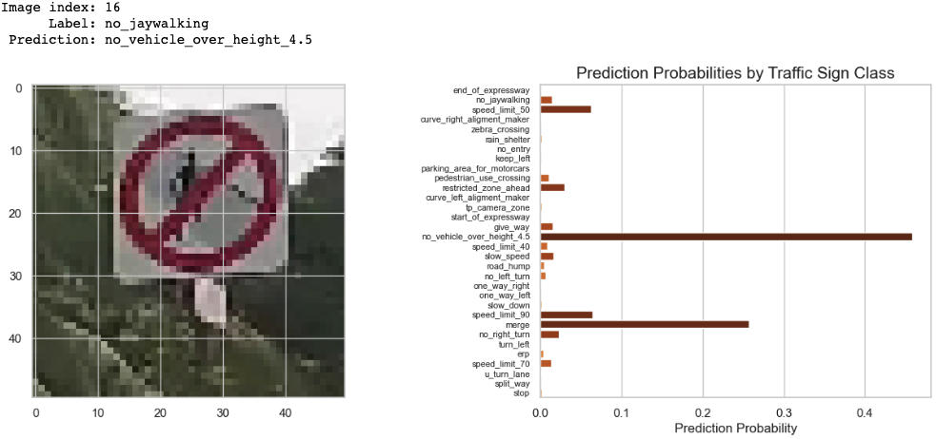

Slide 20
Conclusion
CNN Model_2 has achieved an accuracy score of 90%. In the pre-processing phase, image data-generator features of Tensorflow was used to perform data augmentation, as well as train/validation split. A test set, containing more background clutter and other variances, was used to evaluate our trained model on unseen images.
Out of the 352 images of traffic signs, all of them have been successfully classified except for 35 images which has been miss-classified. This results substantiate that the model has successfully classified around 90% of all the images.

Slide 21
Recommendations
To include more training images of traffic signs that are not so tightly cropped.
To expand the dataset further, as Singapore has a total of more than 80 classes of traffic signs.
To have the models run more epochs if time is not a constraint.
To consider using other transfer learning models such as ResNet50, EfficientNet, etc.

Slide 22
Q&A

